Slide 1
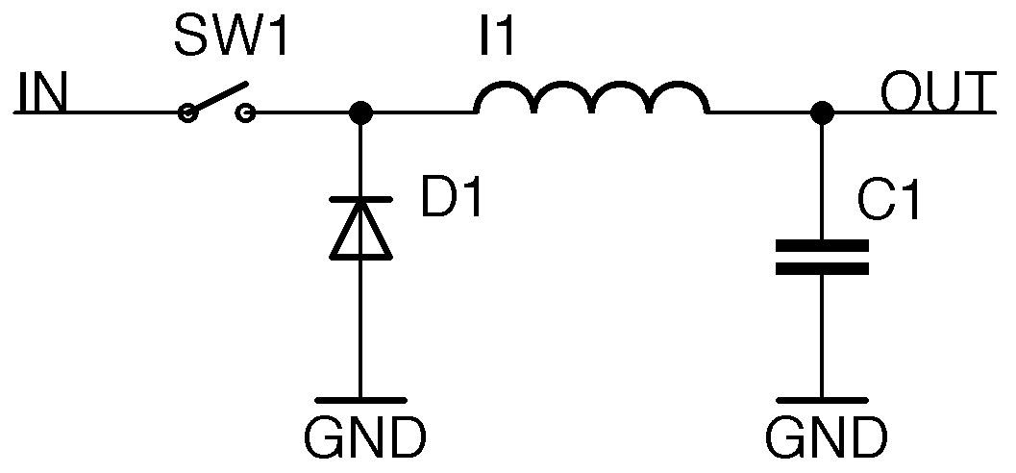
Introduction to Buck Regulators
An Overview and Exploration
By Francisco De La Paz

Slide 2
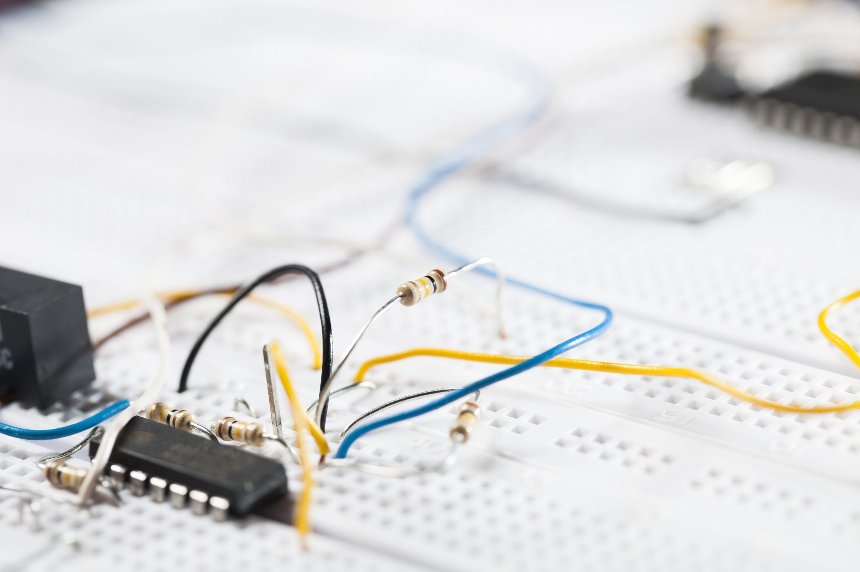
A buck regulator, also called a step-down converter, transforms higher input voltage to a lower, regulated output. It uses components like inductors and capacitors to maintain this output, regardless of input fluctuations. Why did the diode go to the beach? To get tanned!
Notes:
The buck regulator, as the name suggests, steps down the voltage. It's a marvel of electronic engineering, combining various components to maintain a consistent and stable output voltage. This stability is of paramount importance, especially in devices that require precise power regulation. By adjusting and converting high input voltages to more manageable and desired lower voltages, buck regulators ensure the safe and efficient operation of countless electronic devices, from simple gadgets to complex machinery

Slide 3
The buck regulator is pivotal in modern electronics. From power supplies in computers to smartphones, its efficiency makes it indispensable. Its primary role in battery-powered devices is to extend battery life, a crucial function in today's mobile age. Why did the resistor hug the capacitor? For current support!
Notes:
The omnipresence of buck regulators in modern electronics cannot be overstated. Think of all the devices you use daily: computers, smartphones, tablets, wearable tech, and more. All these rely on buck regulators to manage and regulate power. In battery-operated devices, the buck regulator plays a pivotal role in ensuring that the device extracts the most out of every charge, extending battery life, and by extension, the utility of the device. It's an unsung hero, working silently in the background, making our electronic life seamless.

Slide 4
The buck regulator's foremost advantage is high efficiency, especially with minimal input-output voltage difference. This efficiency curtails heat generation, prolongs device life, and minimizes cooling needs. Modern designs even allow for more compact system designs. Why don't electrical engineers get shocked? They're well-grounded!
Notes:
Efficiency is at the heart of why buck regulators are so widely used. In electronic devices, waste, especially in the form of heat, can be problematic. Excessive heat can lead to reduced device lifespans, potential hazards, and energy wastage. Buck regulators combat this by efficiently converting power with minimal losses. Furthermore, as our demand for compact devices grows, so does the need for components that can operate efficiently in smaller footprints without overheating. This is where the buck regulator shines, making modern electronic designs both feasible and efficient.

Slide 5

Despite its merits, the buck regulator has setbacks. Rising switching frequencies can result in electromagnetic interference, complicating designs. Proper component selection is paramount, and specific designs might face limitations in voltage differentials. What did the transformer say to the inductor? 'Feeling current today?'
Notes:
No electronic component is without its set of challenges, and the buck regulator is no exception. One of the significant challenges faced when designing with buck regulators is electromagnetic interference (EMI). As these regulators switch on and off at high frequencies to regulate voltage, they can inadvertently generate electromagnetic waves that can interfere with other components or devices. Managing and mitigating this interference requires careful design considerations, proper component selection, and sometimes, additional shielding or filtering components. It's a delicate balance between harnessing the advantages and managing the challenges.

Slide 6
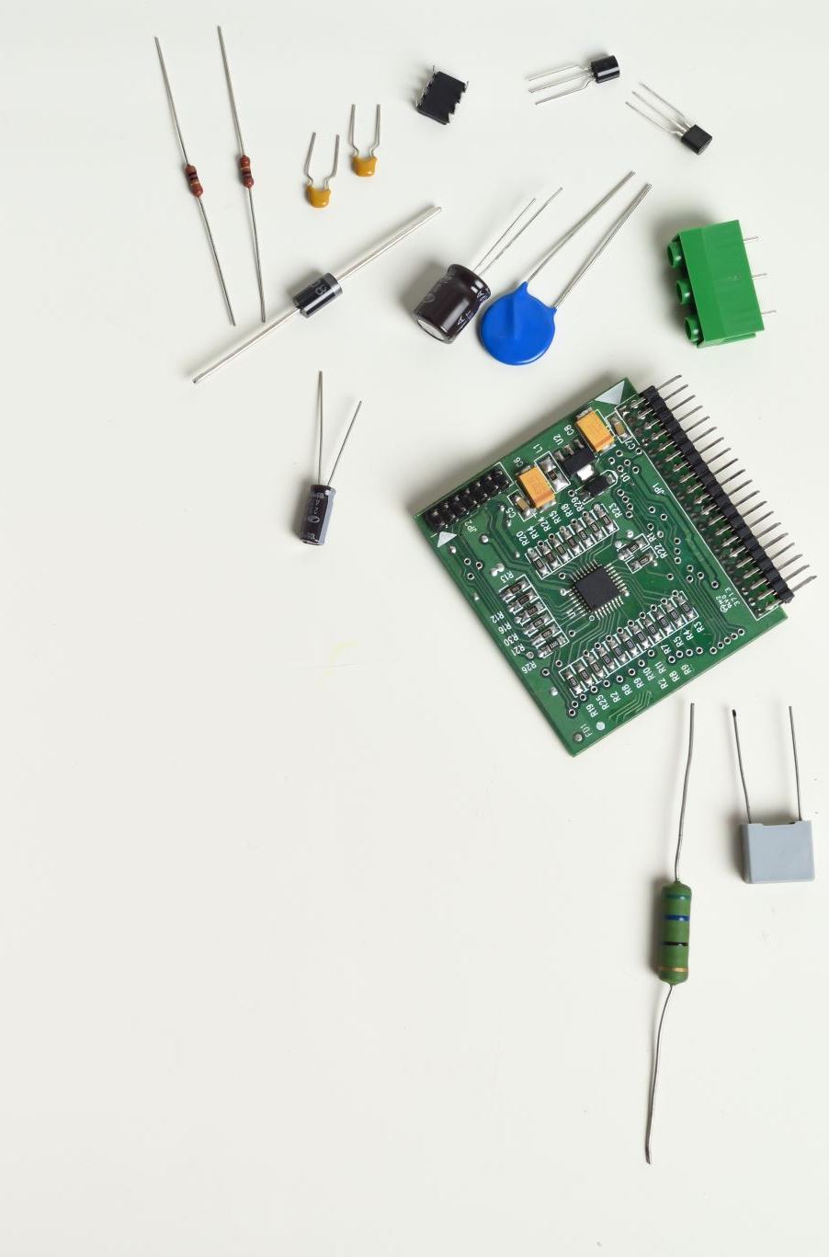
Buck regulators have evolved with variations like synchronous buck regulators and multiphase designs. These aim at specific challenges or applications, offering advanced solutions and integrating control circuits for a more compact footprint. Why did the transistor go to school? To amplify its knowledge!
Notes:
The world of electronics is ever-evolving, and so are its components. Buck regulators have seen numerous variations over the years, each tailored to meet specific challenges or requirements. For instance, synchronous buck regulators offer improved efficiency, especially at lower output voltages. On the other hand, multiphase buck regulators can distribute the current load over multiple phases, allowing for smoother and more efficient operation. These innovations underscore the importance and relevance of buck regulators in modern electronics and highlight the continuous efforts to refine and improve their design and operation.

Slide 7
References
Knight, D. (2015, November 24). Buck converters and their cool applications - technical articles. All About Circuits. https://www.allaboutcircuits.com/technical-articles/buck-converters-and-their-cool-applications/
Bell, B., &amp; Pace, D. (2016, September). Buck regulator topologies for wide input/output voltage differentials. Dallas; Texas Instruments.
Buck regulators. STMicroelectronics. (n.d.). https://www.st.com/en/power-management/buck-regulators.html
ICRFQ.com. (2022, May 23). Everything you need to know about Buck Converters. icrfq.net. https://www.icrfq.net/buck-converters/

